Slide 1

Happy Wednesday
Name Tag
Check-in

Slide 2

Check-in

Slide 3




Using External Secondary Data
Notes:
Chapter 7

Slide 4

iClicker Question
Primary data are those collected by the researchers for the research question at hand and secondary data are those collected for other purposes
True
False

Slide 5

iClicker Question
Why do we need to know who sponsor a research study?
Sponsor can have ulterior motives
Knowing the sponsors can help researchers and readers appreciate them more
Both A and B

Slide 6

iClicker Question
What are the original four V’s of big data?
Volume, Velocity, Variety, Veracity
Volume, Valence, Value, Velocity
Volume, Variety, Valance, Veracity

Slide 7
Recap Last Class
Types of data: primary vs. secondary (internal)
Big Data Introduction
Types of “Big Data” Analyses

Slide 8

Learning Objectives
Describe the process of searching for published external secondary data
List 3 common uses of the information supplied by standard marketing info services
Define geodemography
Define single-source data

Slide 9
Marketing Research Process
In Chapter 7, we shift our focus onto retrieving existing info from external sources. Some of this external info may end up in the company’s Decision Support System; some of it may also be in the form of “big data.”

Slide 10
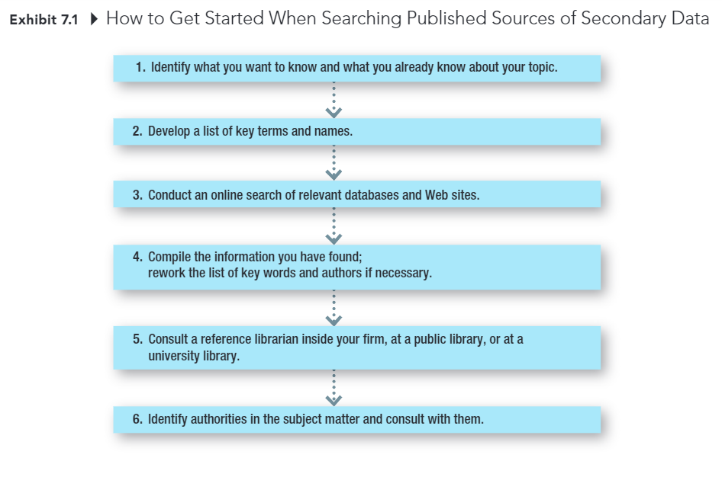
Marketing Research Process
Notes:
This is an overview of how to search for published sources of secondary data
After identifying what you want to know and what you already know about the topic
Then you can develop a list of key terms and names
Conduct an online search of relevant databases and websites
They not need to be in that order. And you can always revise and improve your search process.

Slide 11
Standardized Marketing Information
Secondary data collected by companies that sell the data to multiple companies, allowing the costs of collecting, editing, coding, and analyzing them to be shared.
Notes:
Standardized marketing information are data that are standardized so that they can be used by multiple companies rather than customized for a specific company

Slide 12
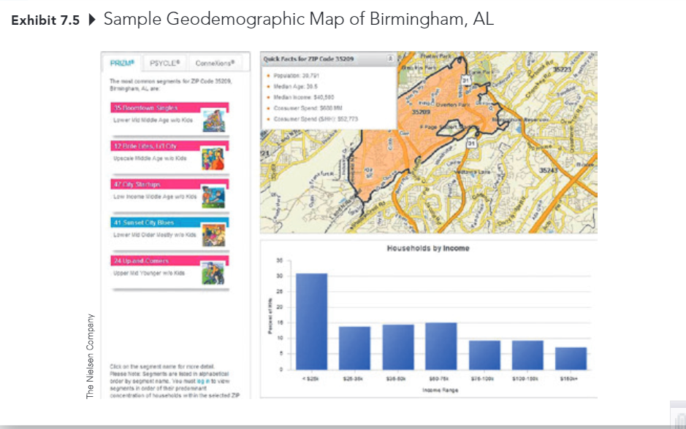
Profiling Customers
Geodemography: the availability of demographic, consumer behavior, and lifestyle data by arbitrary geographic boundaries that are typically quite small.
Notes:
After having data, we can have some visualization
Go to https://bookdown.org/mike/marketing_research/empirical-models.html#geodemographic-classification

Slide 13
Measuring Product Sales Market Share
(Online) Diary Panels Scanners

Slide 14
Measuring Advertising Exposure and Effectiveness
Television and Radio
Nielson TV ratings
Arbitron radio ratings
Print Media
Starch Ad Readership (magazine)
Internet
Nielson Digital Voice
ComScore Mobile Metrix
Cross-platform Services
Simmons National Consumer Study
Gfk MRI
comScore, WebTrends, Nielsen
Notes:
Historically, these are companies that measure advertising exposure and effectiveness

Slide 15
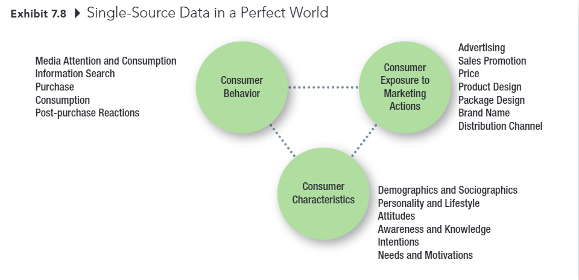
Single-Source Data in a Perfect World
Notes:
You might ask, why couldn’t we have a single-source data
It only exists a perfect world.

Slide 16
Conducting Causal Research
Notes:
Now moving onto Chapter 8

Slide 17
Learning Objectives
Discuss the three general types of primary data research
Clarify the difference between lab experiments and field experiments.
Explain which of the two types of experiments has greater internal validity and which as greater external validity
List the 3 major considerations in test marketing.
Distinguish between a standard test market and a controlled test market

Slide 18
Three types of Primary Data Research
Exploratory Research (explore)
Descriptive Research (describe)
Causal Research (establish cause and effect)
Notes:
A reminder of the three types of primary data research

Slide 19
Three Types of Primary Data Research
Exploratory Research: Research conducted to gain ideas and insights to better define the problem or opportunity confronting a manager.
Descriptive Research: Research in which the major emphasis is on describing characteristics of a group or the extent to which variables are related
Causal Research: Type of research in which the major emphasis is on determining cause-and-effect relationships
Notes:
Review
You can review this slide before taking the quiz

Slide 20
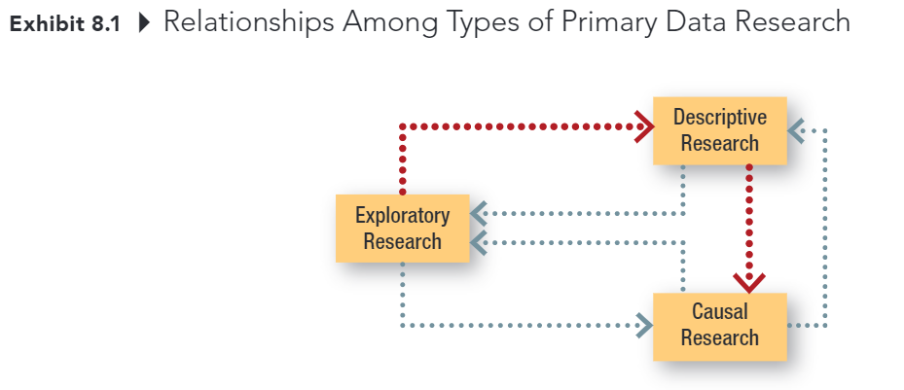
Three Types Primary Data Research
Notes:
This slide will help you visualize the relationship among types of research design.
As you can see, all types of research are interconnected.
I will give you an example of why we conduct causal research after descriptive research
Then can you tell me why after we do causal research, we do descriptive research again?

Slide 21

Causal Research
The purpose of causal research is to test cause and effect relationships
Notes:
condition X causes event Y
A review of causality

Slide 22
Evidence of Causality
Consistent variation – evidence of the extent to which X and Y occur together or vary together in the way predicted by the hypothesis (Correlation condition) spurious correlation
Time order – evidence that shows X occurs before Y
Elimination of other explanations – evidence that allows the elimination of factors other than X as the cause of Y
X – the cause
Y – the effect
Notes:
Correlation does not mean causation.
Even though you can satisfy the first condition, you have to satisfy the other conditions as well in order to establish causal relationship. Hence, many people thought they can
Because we can never know for certain that we have eliminated all other possible causes of an effect, we can never state with certainty that X caused Y.

Slide 23

Types of Test Markets
Market Testing: A controlled experiment done in a limited but carefully selected sector of the marketplace
Standard Test Market: A test market in which the company sells the product through its normal distribution channels.
Controlled Test Market: An entire test program conducted by an outside service in a market in which it can guarantee distribution
Simulated Test Market: A study in which consumer ratings are obtained along with likely or actual purchase data often obtained in a simulated store environment; the data are fed into computer models to produce sales and market share predictions.

Slide 24
Construct and Variables
Construct is “an abstract idea or concept composed of a set of attitudes or behaviors that are thought be related.”
Conceptual/Theoretical Domain
Construct A
Construct B
Variables are ”elements of a construct that can be measured or quantified”
Variable X
Variable Y
Real world
Notes:
I hope you guys did read or at least skim this chapter. Because what I am going to talk about is PhD-level knowledge.
In social science, when we want to formulate a theory, we only do it in the conceptual world that contain constructs.
Construct is “an abstract idea or concept composed of a set of attitudes or behaviors that are thought be related.”
Variables are ”elements of a construct that can be measured or quantified”
They are called variables because they can take on different values, that is, they can vary
I know this still seems rather vague; we will go into an example in the next slide
If you can understand the difference between constructs and variables, you already finish a quarter of your phd.

Slide 25
Example
4 ads, what is the “best” ad?
What info we need to determine the best ad?
Memorable?
Relevant?
Most believable?
Least likely to be misinterpreted?
Most likeable?
Most likely to produce a favorable attitude?
Mostly likely to produce an intention to buy the advertised product?
These questions represent the different constructs
Memory
Relevance
Believability
Understandability
Likeability
Attitude
Purchase Intention
Notes:
4 ads, what is the “best” ad?
What info we need to determine the best ad?
Memory: Memorable?
Relevance: Relevant?
Believability: Most believable?
Understandability: Least likely to be misinterpreted?
Likeability: Most likable?
Attitude: Most likely to produce a favorable attitude?
Purchase Intention: Mostly likely to produce an intention to buy the advertised product?
These questions represent the different types of info we could collect.
Each is a separate construct

Slide 26

iClicker Question
I think you should give the general conceptualization first, then the example
I think you should give the example first, then the generalization
I have no ideas what you just talk about

Slide 27
Descriptive Analysis
Describe some characteristics of your respondents
How often do they eat out at a restaurant?
Where do they usually shop for groceries?
How much do they pay for a Valentine’s Day bouquet?
Which of several promotional packages do you prefer?
Notes:
Most research questions in your project will be this type. You will simply describe some characteristics of your respondents such as how often they eat out at a restaurant,
where they usually shop for groceries,
how much they would pay for a Valentine’s Day bouquet, or
which of several promotional packages they prefer

Slide 28
Difference Analysis
Whether subgroups of your sample differ on some characteristics.
A difference analysis RQ has both a grouping variable and a comparison/analysis variable.
Is there a difference between on and off-campus students regarding how often they want pizza delivered?
Do residents of the three main zip codes in Columbia differ in the frequency with which they shop in downtown Columbia?
Notes:
In this type of research question, you are examining whether subgroups of your sample differ on some characteristics. For example, you might want to know if on- and off-campus students differ in how often they want pizza delivered. A differences analysis RQ has both a grouping variable and a comparison variable
The analysis variable is what you compare your subgroups on.
RQ 1: Do Greek and non-Greek students differ in their favorite place to buy clothes in Columbia? The grouping variable is Greek vs. non-Greek; the analysis variable is the favorite place to buy clothes.
RQ 2: Do residents of the three main zip codes in Columbia differ in the frequency with which they shop in downtown Columbia? The grouping variable is zip code of residence; the analysis variable is the frequency of shopping in downtown Columbia.

Slide 29
iClicker Question
What are the two variables of interest in this RQ?
“Do Greek and non-Greek students differ in their favorite place to buy clothes in Columbia? “
Greek vs. non-Greek
Favorite vs. non-favorite location
Greek life status vs. favorite location

Slide 30
Association Analysis
This RQ answers if there's a relationship or association between two variables.
An association RQ always involves two variables and requires two separate questions on a questionnaire (one to measure each variable).
Does income correlate with how many vacations a person takes?
Does family size is associated with how often a family eats out?
Does per week study hour correlate with the grades students get?

Slide 31
Association Analysis (cont.)
Association analysis might sound similar to difference analysis.
The major difference is that in association analysis, both variables have order/rank, such as small family size, medium family size, and large family size.
Notes:
The frequency of eating out can be infrequent, medium frequent, and frequent.
Then you can say if family size increases, the frequency of eating out decreases or vice versa.
Thus, association analysis is a special case of difference analysis.

Slide 32
Another representation
Categorical/
Discrete
Difference
Analysis
X
Y
Continuous
X
Y
Association
Analysis

Slide 33
What if – Regression Analysis
Categorical/
Discrete
X1
Y
Continuous
X2
Notes:
We will learn more about this in chapters 17 and 18

Slide 34
DISCUSSION CASE #3
A. For each research question below, indicate the research question form (descriptive, differences, or association research question).
B. In addition,
For each descriptive RQ below, describe the variable to be measured.
For each difference RQ below, describe both the grouping variable and the analysis variable.
For each association RQ below, describe the two variables to be associated.
RQ1: How often do Columbia residents buy floral items (potted plants, bouquets, arrangements, etc.)?
RQ2: Is household income associated with the frequency of buying floral items?
RQ3: Do married people buy more floral items than single people?
RQ4: Are Columbia residents more likely to buy their floral items at a supermarket or at a florist shop?
RQ5: What percentage of Columbia residents have a favorite florist?
RQ6: What percentage of Columbia residents have purchased floral items via the internet?
RQ7: Are men or women more likely to purchase floral items via the internet?
RQ8: What is the average price residents pay for floral items?
RQ9: For what sorts of occasions are they most likely to buy floral items?
RQ1O: Is age related to how often a person purchases floral items?

Slide 35

Assignment 3.5
Revise assignment 3
Highlight your changes
Due by Sunday
Notes:
Might be 10 mins

Slide 36
Reminder
New Customers: Raise Awareness
Existing Customers: Raise Satisfaction
Notes:
Need to be consistent. You can’t target new customers, then all your questions are for existing customers. This inconsistency will cost you points.

Slide 37
Recap
Reminder: Evidence of Causality
Constructs vs. Variables
Analyses:
Descriptive
Difference
Association

Slide 38
Up Next
Week 4 Quiz (Sunday)
Assignment 3.5 (Sunday)

Slide 39

5-min Snippet
Sales Funnel
Customer Segmentation
Notes:
https://bookdown.org/mike/marketing_research/empirical-models.html#sales-funnel

